Slide 1
Dinghy
Mattias, Niklas, David, Fredrik, Jesper, Alexander, Björn

Slide 2
Hur ser systemet ut?

Slide 3
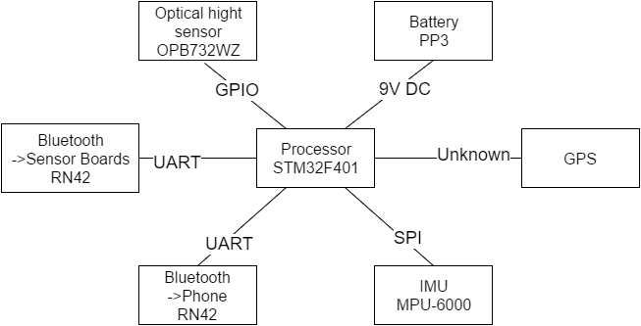
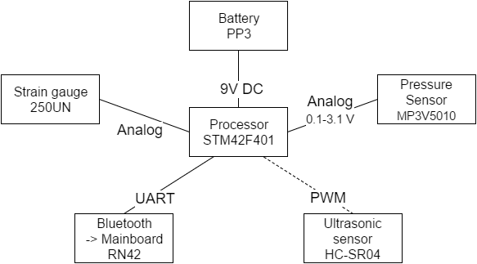
Sensor Node
Main Board

Slide 4
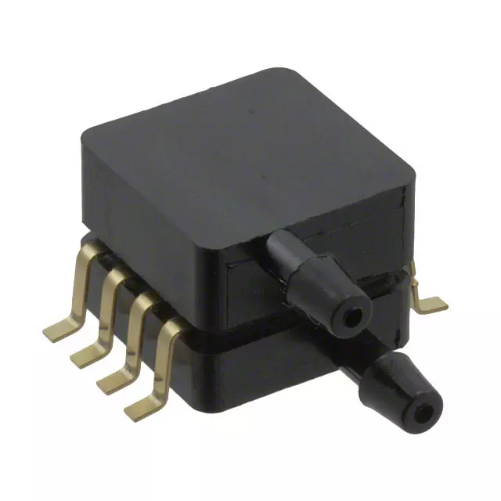
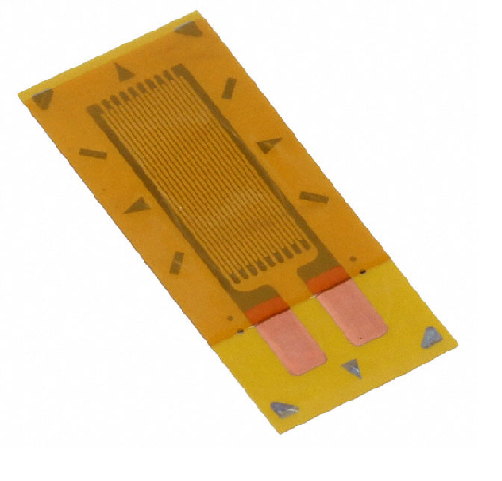
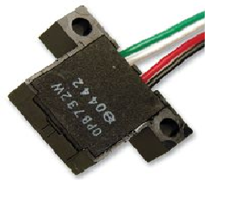
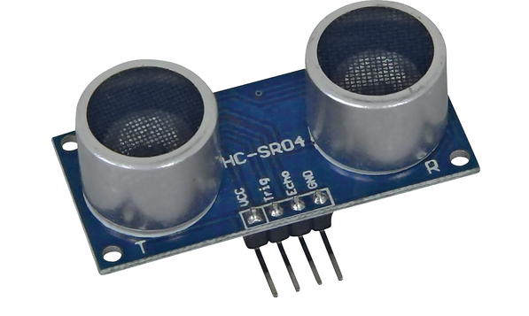
Sensors
Pressure sensor for centerboard MP3V5010DP
Strain gauges on centerboard 250UN
Ultrasonic sensor for height of centerboard HC-SR04
Optic sensor for measuring strips on centerboard OPB732WZ

Slide 5
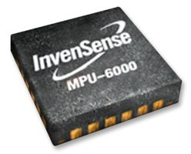
Position and Orientation
MPU-6000 for inclination
3 axis gyroscope and accelerometer

Slide 6
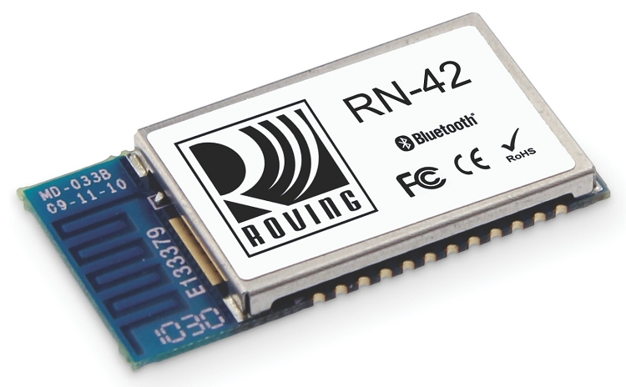
Components and Communication
RN42 bluetooth module

Slide 7
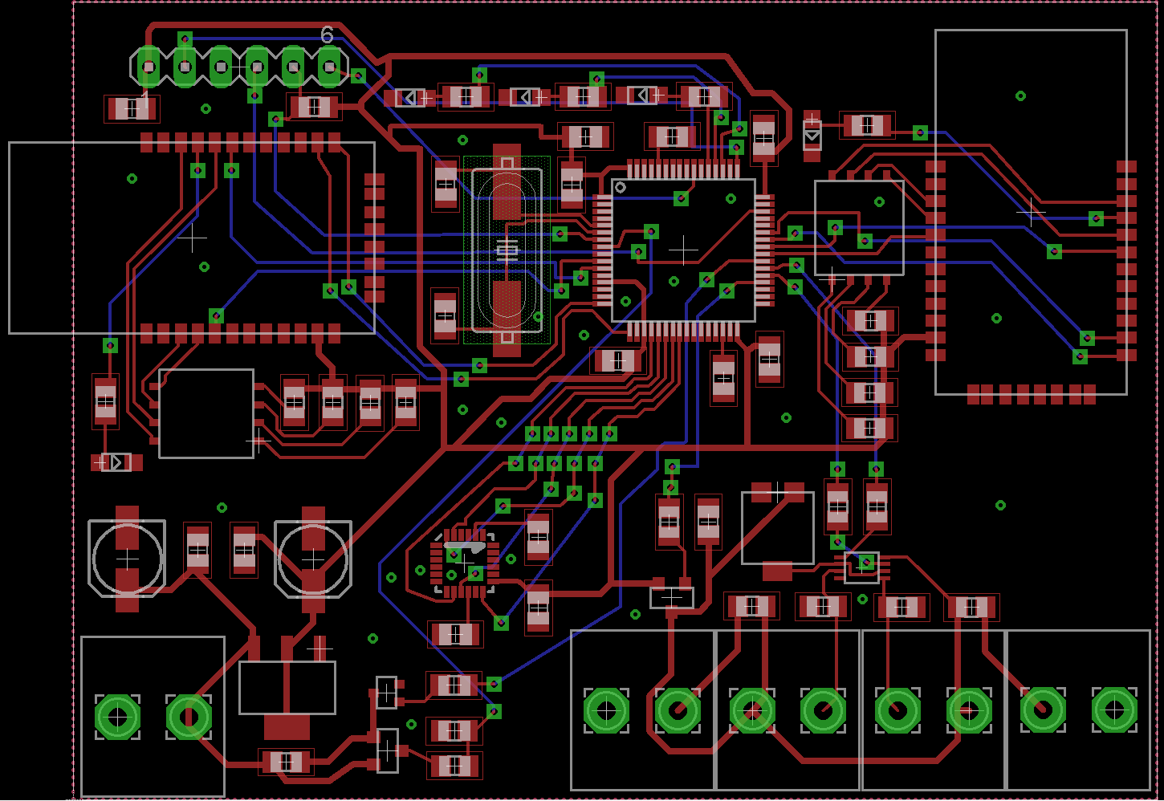
MAINBOARD

Slide 8
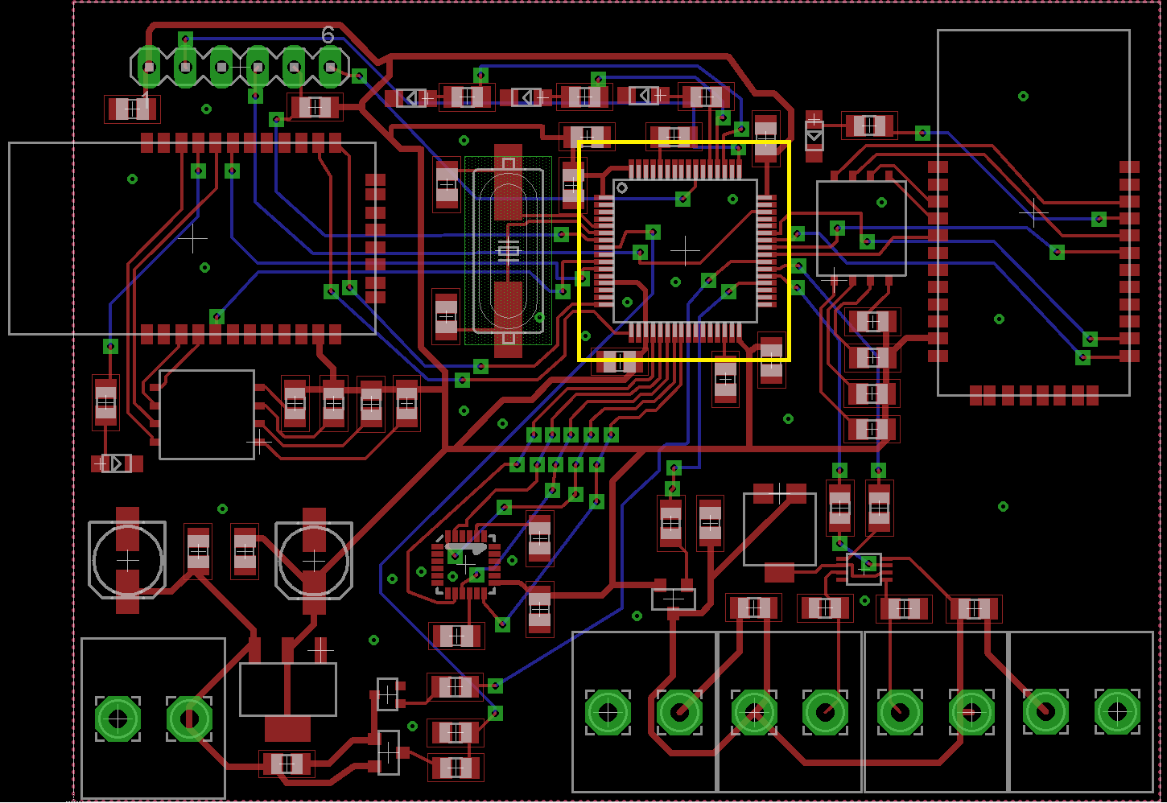
MAINBOARD
MCU

Slide 9
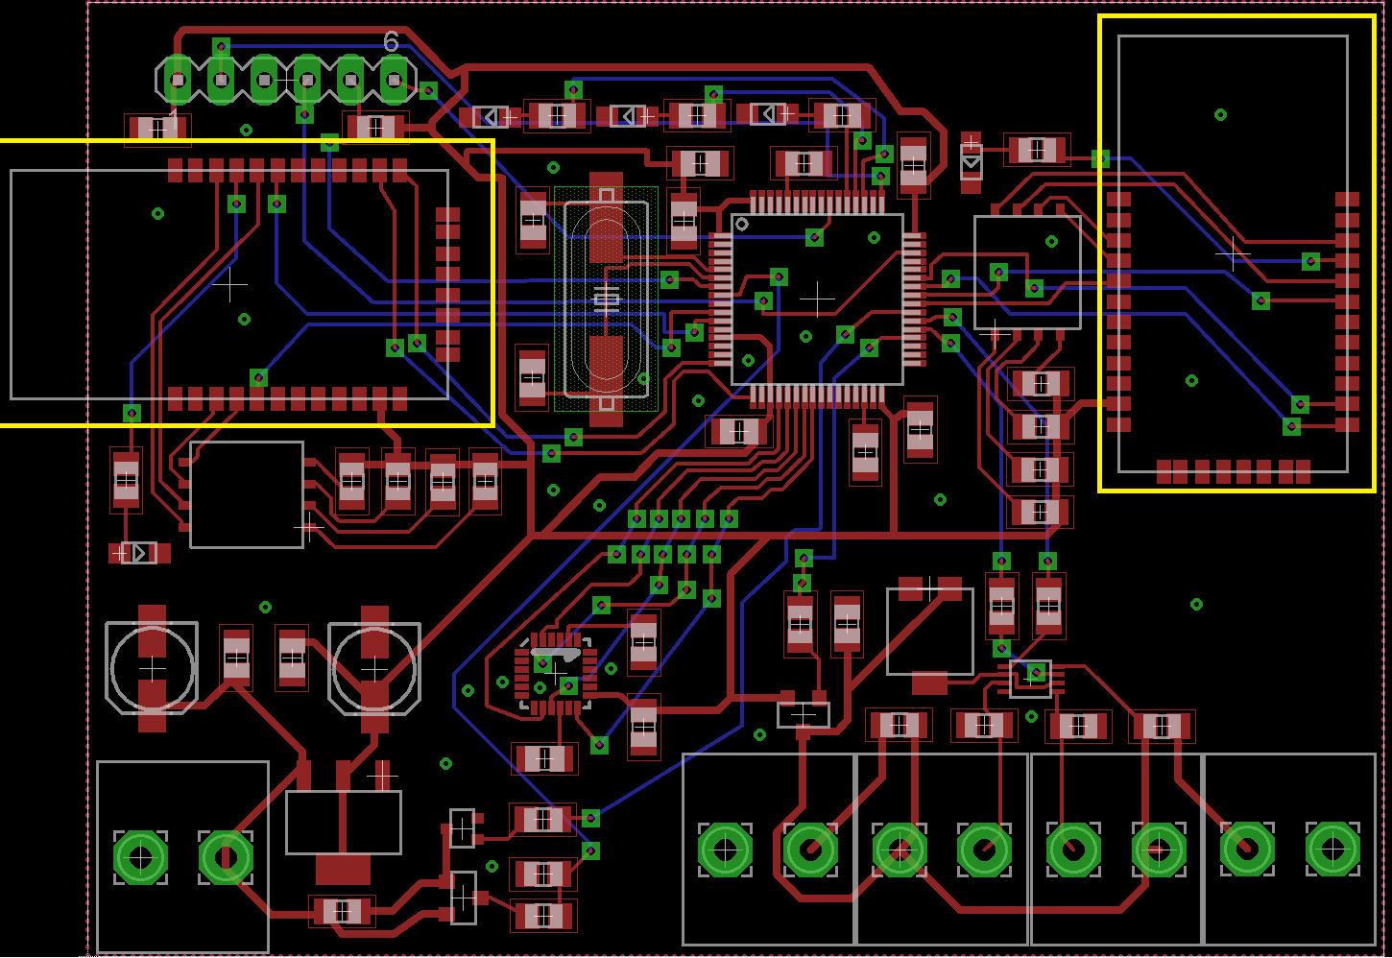
MAINBOARD
Bluetooth

Slide 10
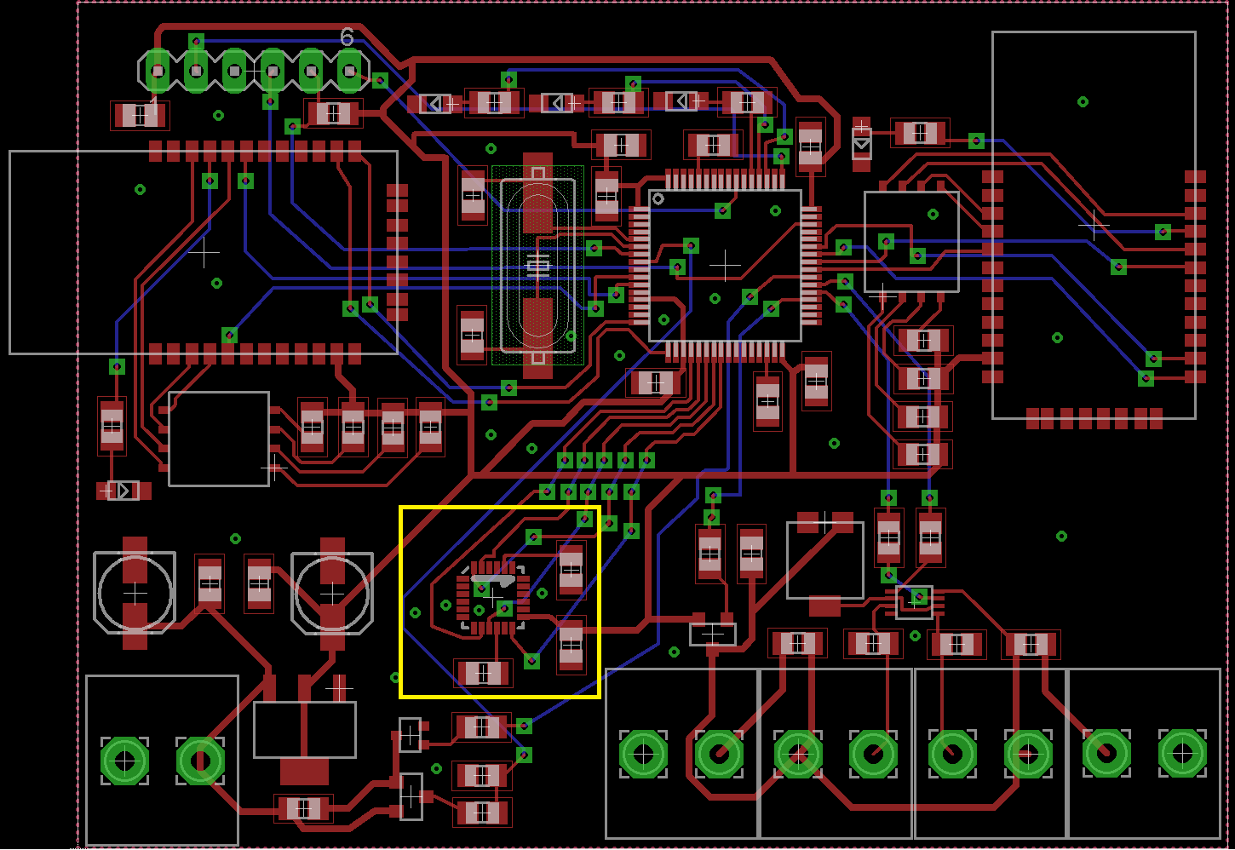
MAINBOARD
IMU

Slide 11
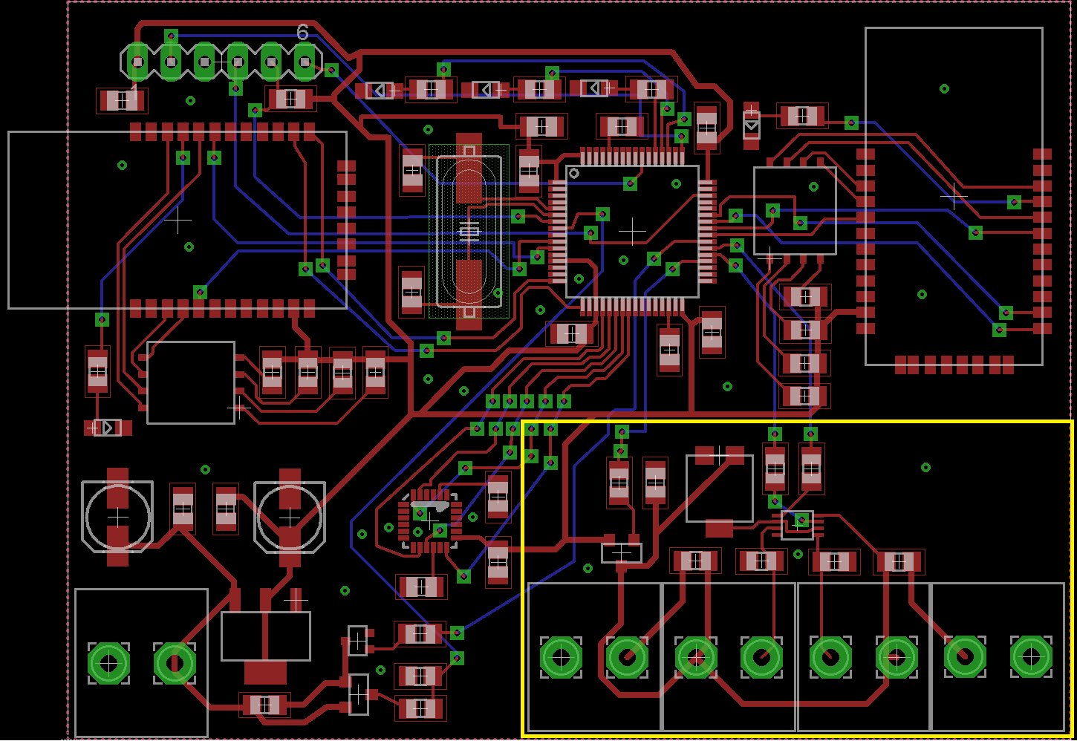
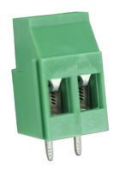
MAINBOARD
Photosensor

Slide 12
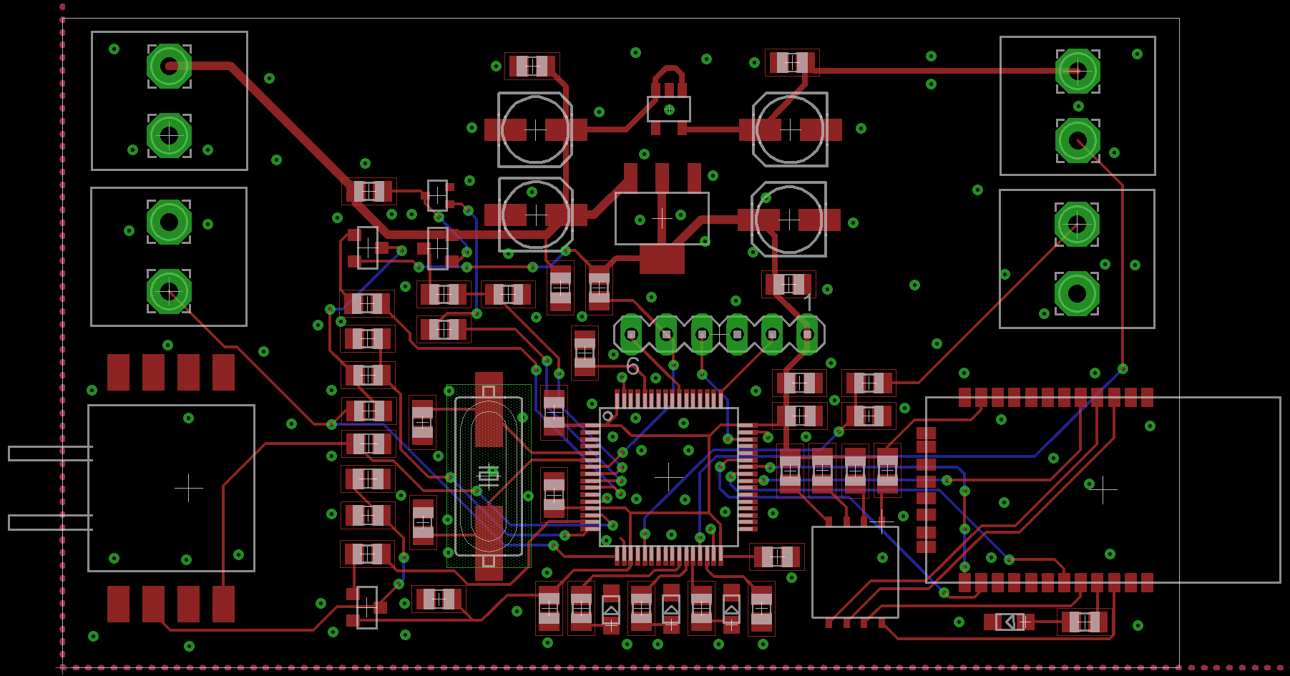
CENTERBOARD

Slide 13
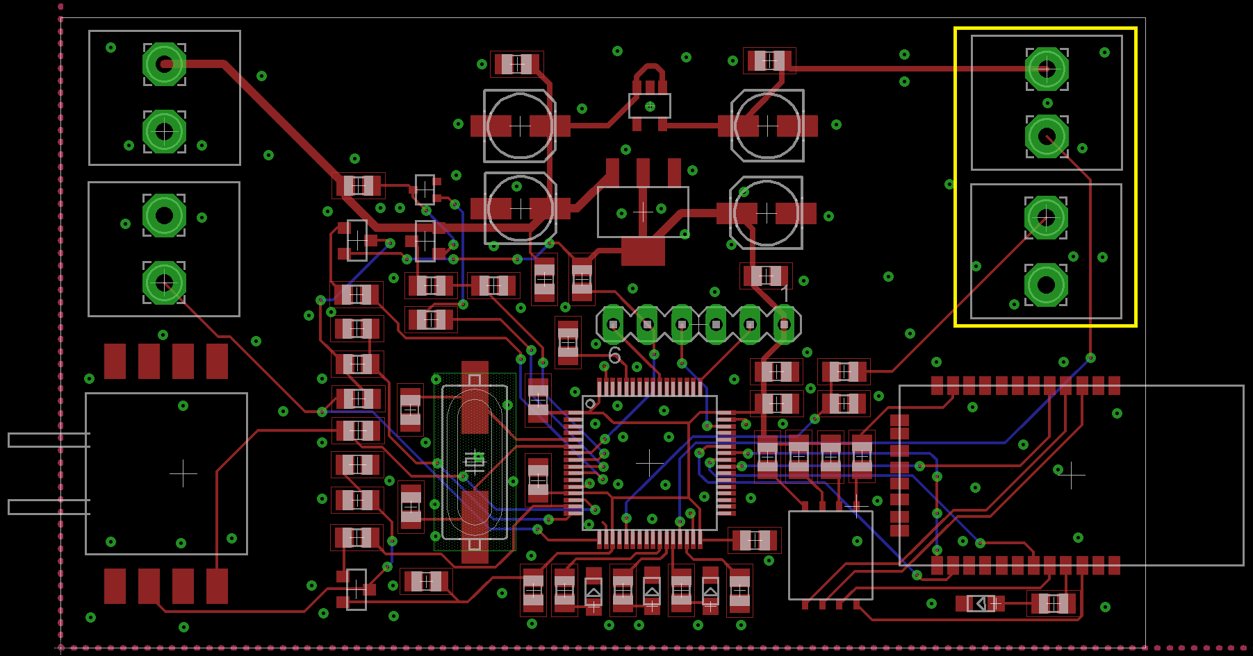
CENTERBOARD
Ultrasonic sensor

Slide 14
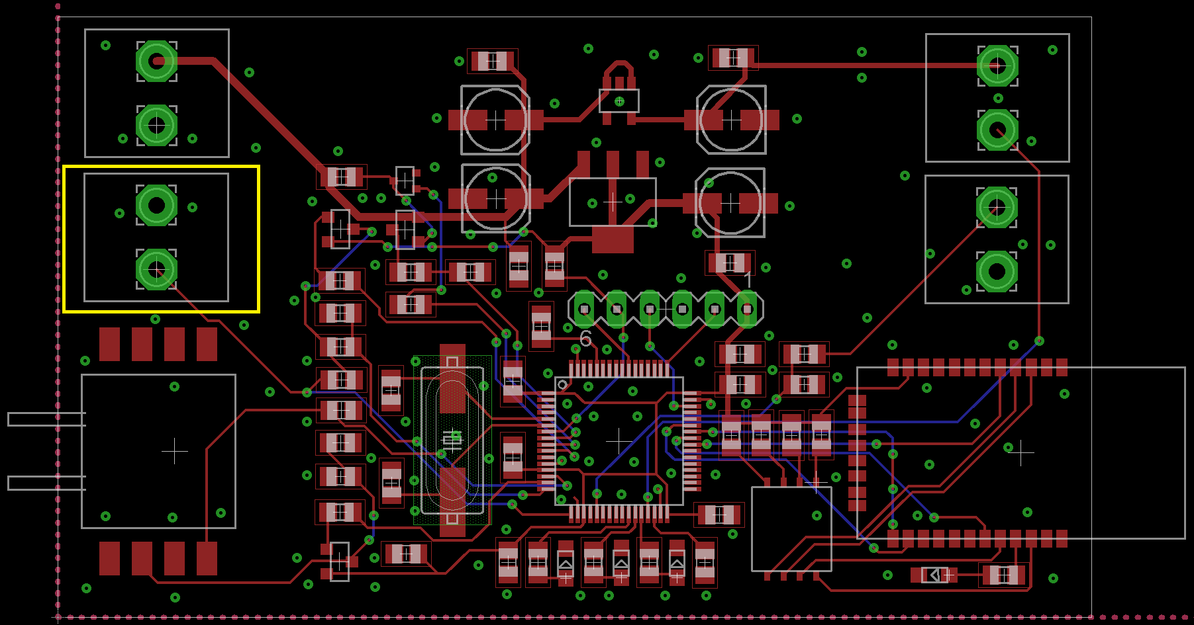
CENTERBOARD
Strain gauge

Slide 15
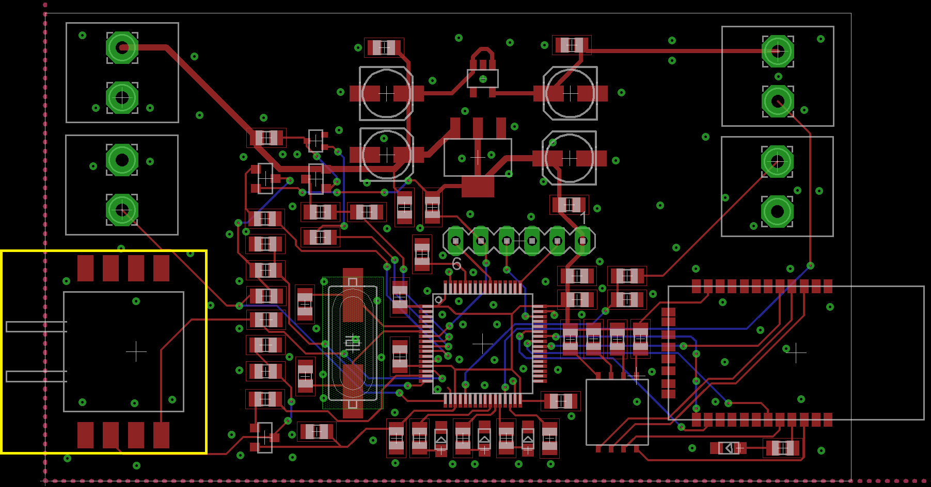
CENTERBOARD
Pressure sensor

Slide 16
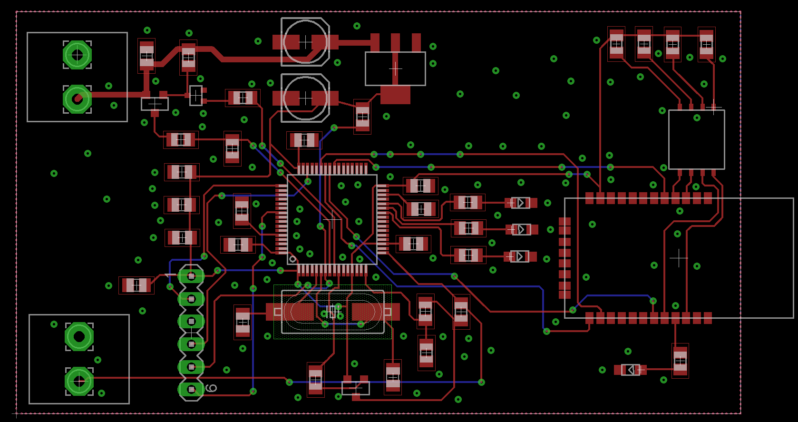
RUDDER

Slide 17
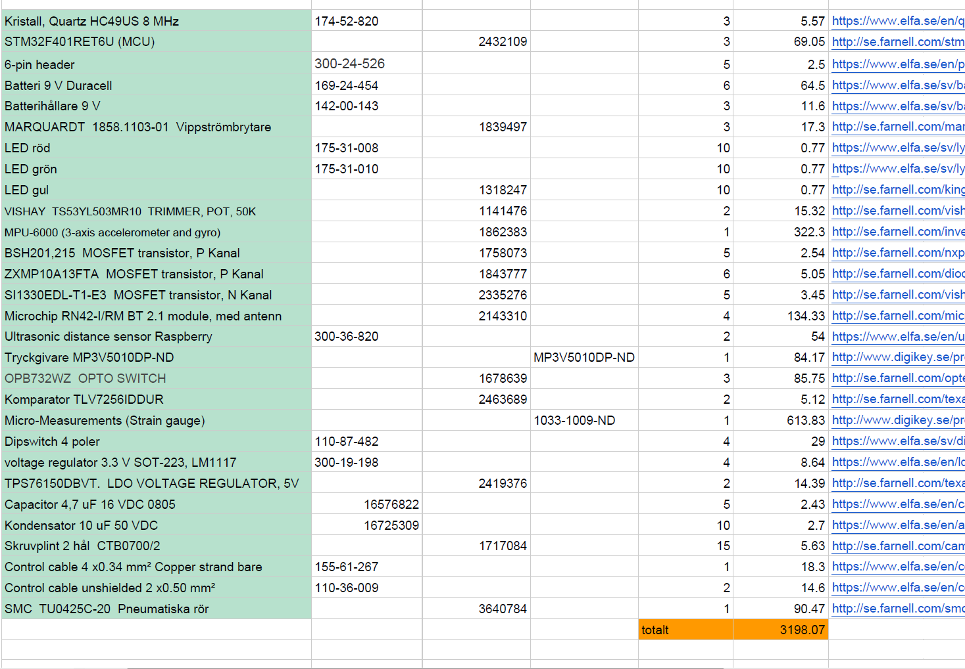

Slide 18

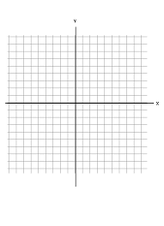
Application

Slide 19
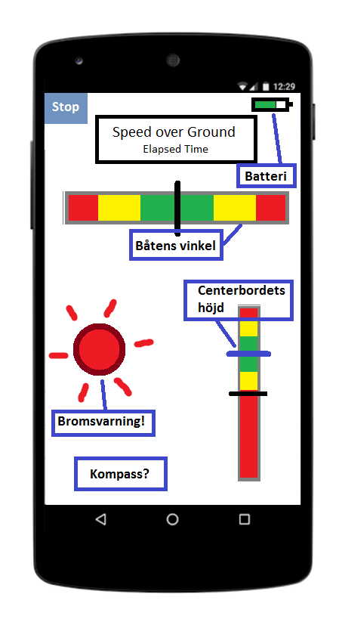
Application
Ideas

Slide 20
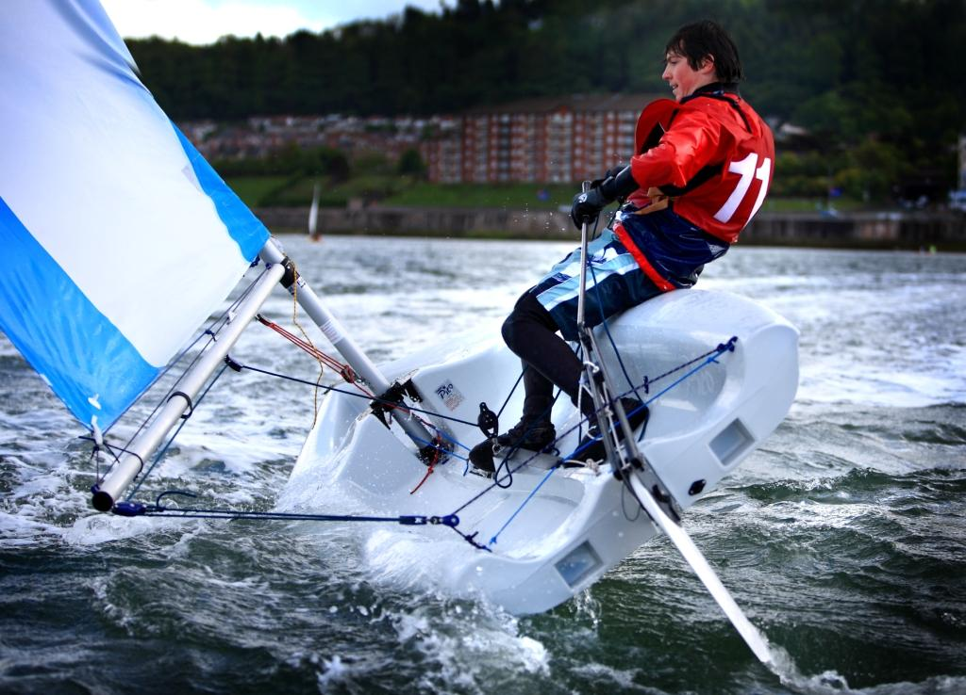
Real-time feedback
Meeting with Erik Gustafsson
Silva Nexus (NMEA)
Centerboard extra pressure sensor
Digital compass
Wave patterns
Compare Speed over Ground/Water
SAFT battery
Labview tests with binary dummy data
Notes:
We had a meeting with Erik yesterday. He thought we had come a far way and liked our solution so far. He had some ideas for improvements but also noted that we needed to set a clear scope for our project so we are done by our deadline.
We had some flaws in how we thought the centerboard worked. For dinghy’s the centerboard is not meant to act as a counterweight to pull the boat down which it is more meant to do for bigger boats. The centerboard is merely there as an extra stiff rudder so the dinghy won’t drift with the wind.
The thing that had us most interested was to implement a port for NMEA communication on our main node. NMEA is a universal communication protocol for marine systems. This means that in the near possible future if we would like to add some instrument or sensor it could easily be done if we had such a port.
Another idea we thought was interesting was adding an extra pressure sensor on the front part of the centerboard so that we can measure the speed of water current and compare this to our GPS’s speed over ground.
He also mentioned some extraordinary battery which was manufactured by SAFT, which he had used himself. The battery was said to last n-times longer than a normal battery.
Maneuvering waves is a big part of dinghy sailing, so we also thought it could be cool if we could locate some patterns to see how the user maneuvers around them, but this would be hard to implement if we can’t test our product.
We’ve conducted tests with some dummy data in labview.

Slide 21
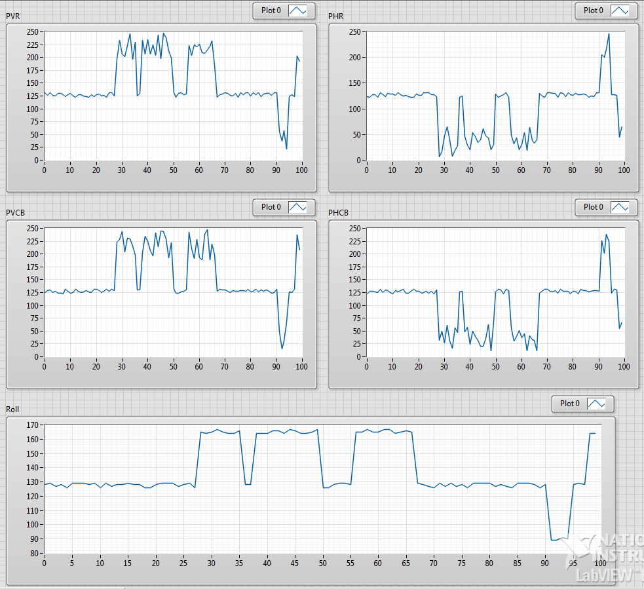
Logging and statistics
Dummy Data
Överfört till labview
Notes:
Dummy data kan nu genereras
Dummy datan är överförd till labview
Här ser vi rudder och centerboard data och även lutning
Motivation = analysis*

